Slide 1

Septic Tank Phase Out Updates
August 31, 2020

Slide 2
Communities are funding the septic tank phaseout programs using various methods including grants
Grants are very limited
  Water Management Districts
    Florida Springs and Aquifer Protection Act, $50M annually for 20 years beginning in 2016
    South Daytona $826K total construction cost (District contribution $205K)
    City of Minneola $2.4M total construction cost (District contribution $778K)
  FDEP Springs Funding
    Septic Upgrade $10K per advanced onsite system
    Citrus, Hernando, Leon, Marion, Orange, Pasco, Seminole, Volusia and Wakulla
  City of Rockledge grant dollars and $1.2M legislative appropriation (no assessment)

Slide 3
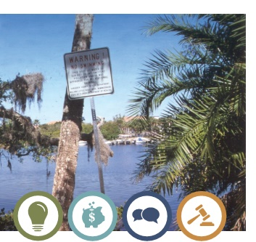
Communities are funding the septic tank phaseout programs using various methods
Non Ad-Valorem Assessment + Other Sources
  Loxahatchee River District pays 10% of the cost, remainder is non ad-valorem assessment
  Charlotte County pays if >$11,500 per ERC, also has a hardship program
  City of Cape Coral one-time assessment for all parcels plus variable fees per property based on actual costs
  Sarasota County $1,000 early incentive refund/credit also has received grants but majority on assessment
Enterprise Funds
  Hillsborough County, City of Hollywood

Slide 4
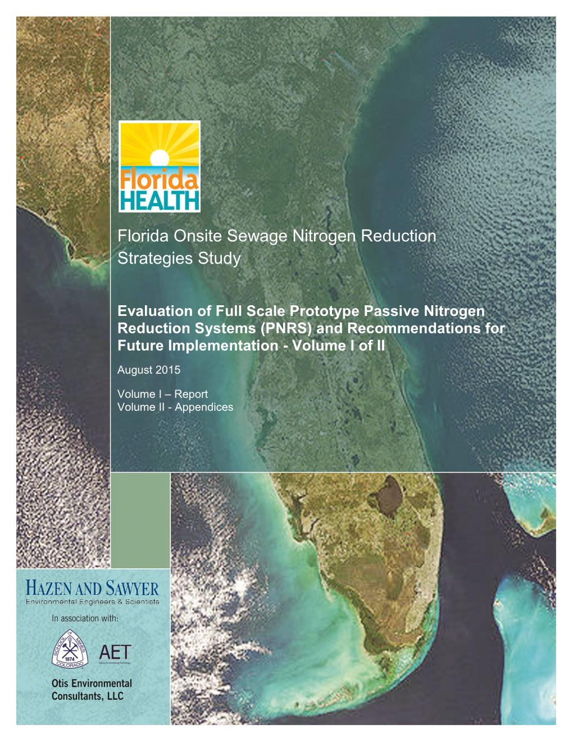
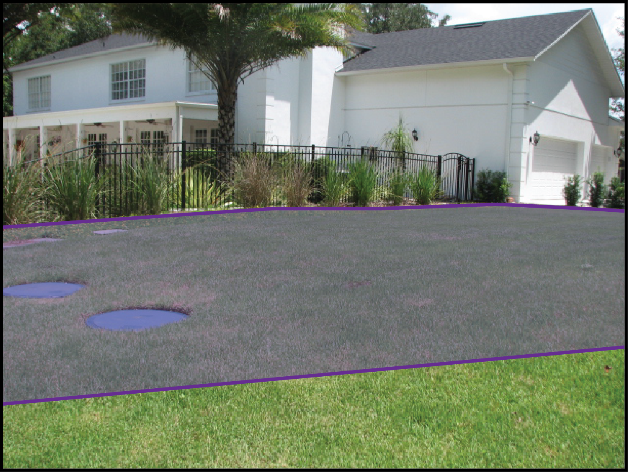
The Florida Dept of Health also researching cost effective advanced septic system treatment methods
Onsite treatment and reuse area

Slide 5
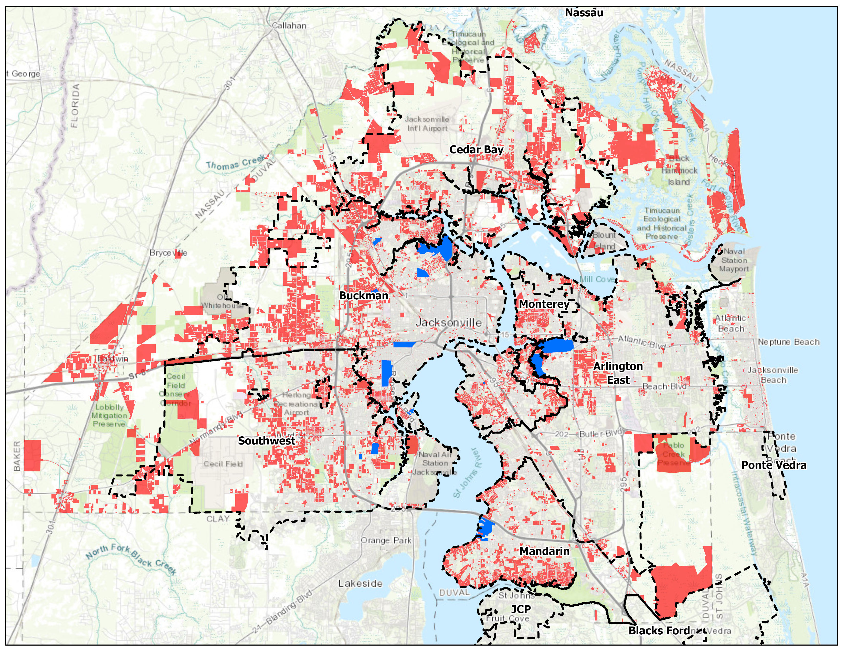
COJ and JEA have an active septic tank phaseout (STPO) program
STPO Areas Converted or
In-Process
65,000 septic systems and 35,000 private water wells remain >$2B
In 2003 Water & Sewer Infrastructure Task Force identified Septic Tank Failure Areas

Slide 6
JEA has used a variety of funding sources for previous Septic Tank Phase-Out projects
Septic Tank Phase-Out Project Funding
Better Jacksonville Plan Projects | Total Funding
City of Jacksonville 0.5% Sales Tax | $75.0
FDEP Grants | $10.0
Water Sewer Expansion Authority | $6.0
City of Jacksonville General Fund | $2.5
Total | $93.5 million
JEA Contribution
2016 Contribution* | $15.0
2019 Contribution ** | $15.15
Total | $30.15 million
*One time $15M contribution, to be matched by COJ, as part of the 2016 5 year contribution extension
** One time $15.15M contribution from the Southside Generation Station property sale

Slide 7
STPO project areas are prioritized annually
Environmental, Health & Welfare | Community Considerations
Department of health score (septic system repair permits) Proximity to St. Johns River Water quality benefit Fecal coliform impairment | Age of development Median home value Private water wells Undeveloped lots Economic development

Slide 8
STPO project area matrix developed with input from DOH, COJ and JEA

Slide 9
STPO Project Area Matrix
Top 3 Prioritized Areas
 | Environmental, Health & Welfare (Max. 70 points) |  |  |  |  |  | Community Considerations (Max. 30 points) |  |  |  |  |  | Overall
Area | DCHD | No. of Units | No. of Units | Factor For Lots | Impaired | Environ, Health | Development | Median | Water | Elimination | Offsite Economic | Community
Designation | 2016 | Within | Within | Within The | Tributary | & Welfare | Prior to | Home Value |  | of Future | Development | Considerations | Total
 | Score | Area | 150M Buffer^{A} | 150 M Buffer | Exceedance | Score | 1968 |  |  | Proliferation | Opportunities | Score | Score
 | (60 pts)^{D} |  | (BMAP) |  | Factor^{C} |  | 10 pts | 5 pts |  | 5 pts | 5 pts
Biltmore C | 49.00 | 173 | 135 | 4 | 0.00 | 53.00 | 10 | 5 | 5 | 2.7 | 2.0 | 24.7 | 77.70
Beverly Hills | 60.00 | 695 | 279 | 2 | 1.35 | 63.35 | 10 | 4 | 0 | 0.1 | 0.0 | 14.1 | 77.45
Christobel | 49.76 | 289 | 62 | 2 | 2.20 | 53.96 | 10 | 5 | 1 | 3.8 | 2.0 | 21.8 | 75.76

Slide 10
Current STPO Project Updates
Biltmore ‘C’:
  Currently under construction
  Forecasted completion – late August 2021
Beverly Hills West:
  Design & permitting completed.
  Anticipate advertise for construction bids in early September 2020
  Forecasted construction start – early March 2021
Beverly Hills Offsite Force Main:
  Construction bids received July 21, 2020
  Forecasted Notice to Proceed – Mid-September 2020
Beverly Hills East:
  60% design completed
  100% design submittal due December 24, 2020
  Forecasted construction start – late July 2021
Christobel:
  JEA Outreach and Town Hall meetings – no activity at this time
  Current program funding adequacy to be assessed after receipt of Beverly Hills West and East bi
*Information updated 8/26/20

Slide 11
Biltmore C Costs
Initial Set up and Outreach | $ 247,400
Survey & Engineering | $ 1,274,645
CEI | $ 684,986
JEA | $ 360,618
Construction | $ 16,100,000
TOTAL | $ 18,667,649
Cost per Lot | $ 53,033.09

Slide 12
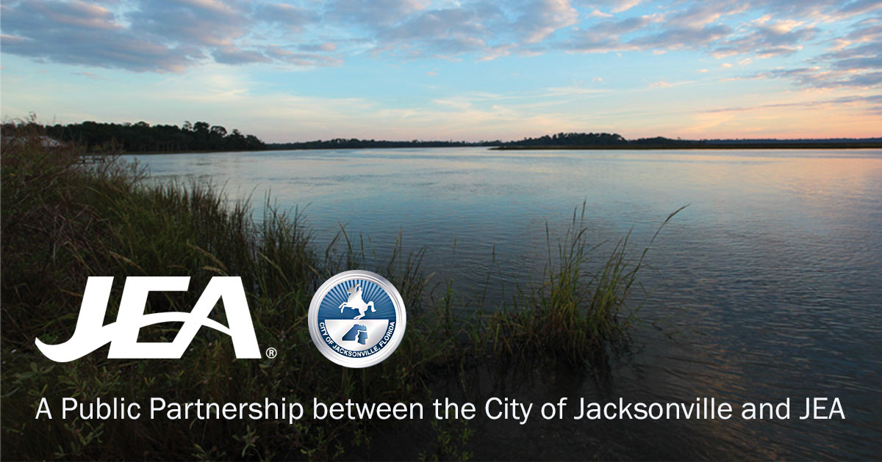

In 2019, JEA sought innovations in alternatives to septic systems
Select the best wastewater management strategy solution for each STPO priority area
Recognize technological advances
Evaluate possible program cost reductions
12

Slide 13




The overarching goal of the Master Plan is to optimize the phaseout program – while recognizing realistic financial considerations
.
.
.
.
Phase 1
Technologies Literature and Industry Best Practices Review and Screening
Phase 2
Geographical Master Conceptual Plan
Phase 3
Phase 4
Potential Pilot Testing
Public Education

Slide 14






Phase 1 and Phase 2 look at:
Institutional
Frameworks
Treatment
Technologies
Management
Strategies
Funding
Master Plan

Slide 15

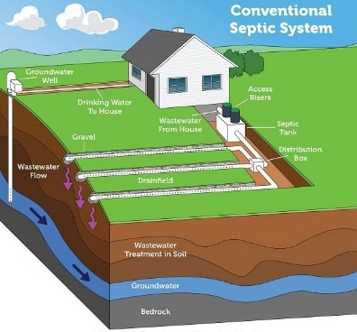

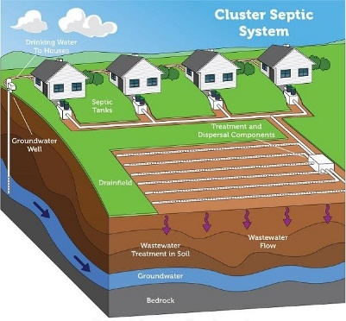

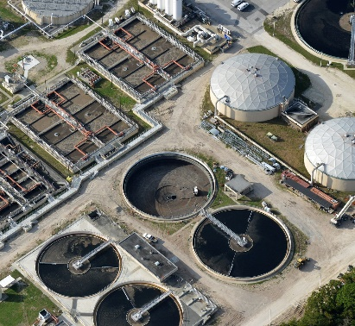
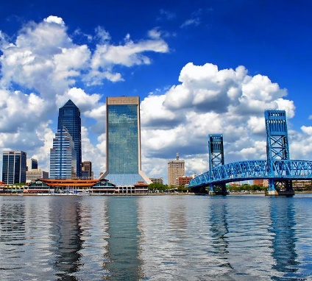

Master Plan work started with a literature and industry best practices review to identify possible solutions
  Single dwelling or building
  on-lot collection, treatment and disposal
Onsite
  Multi-source collection
  small-scale treatment facility
Decentralized
  Multi-source collection
  large (existing JEA) treatment facility
Centralized
  Hybrid
  combination of above
Integrated Management

Slide 16
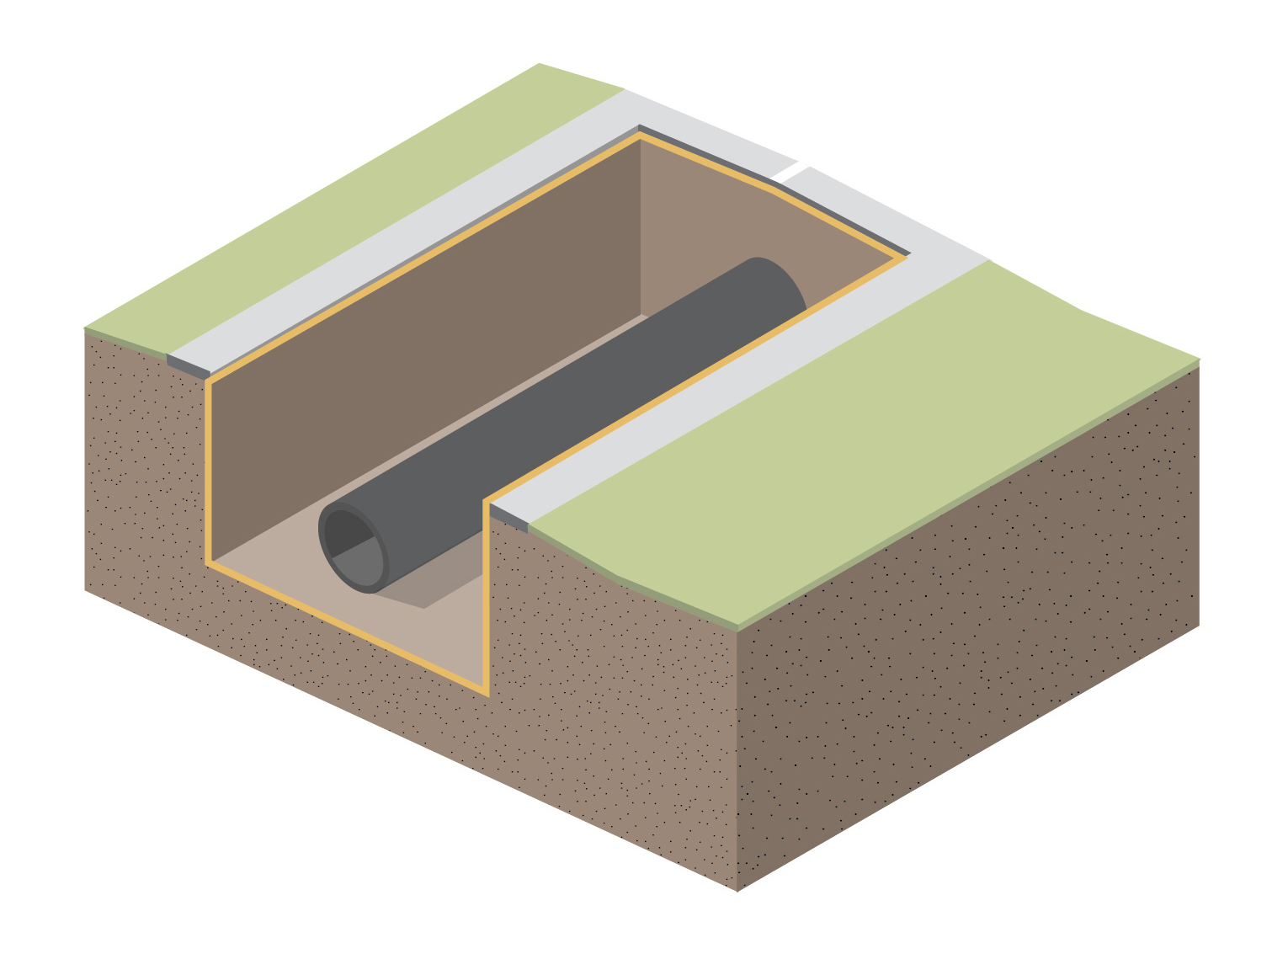
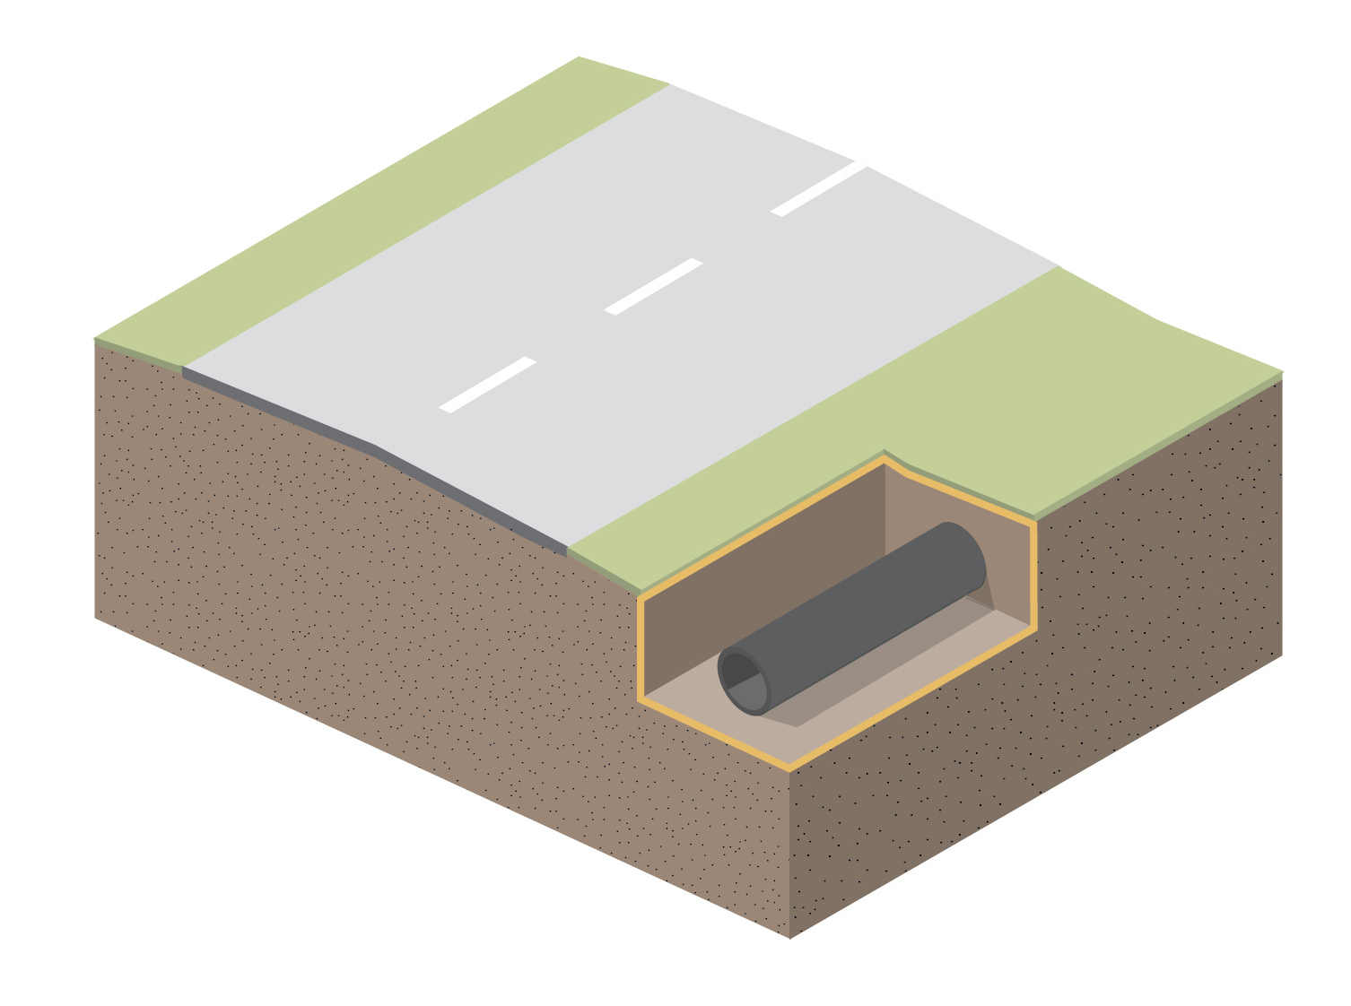
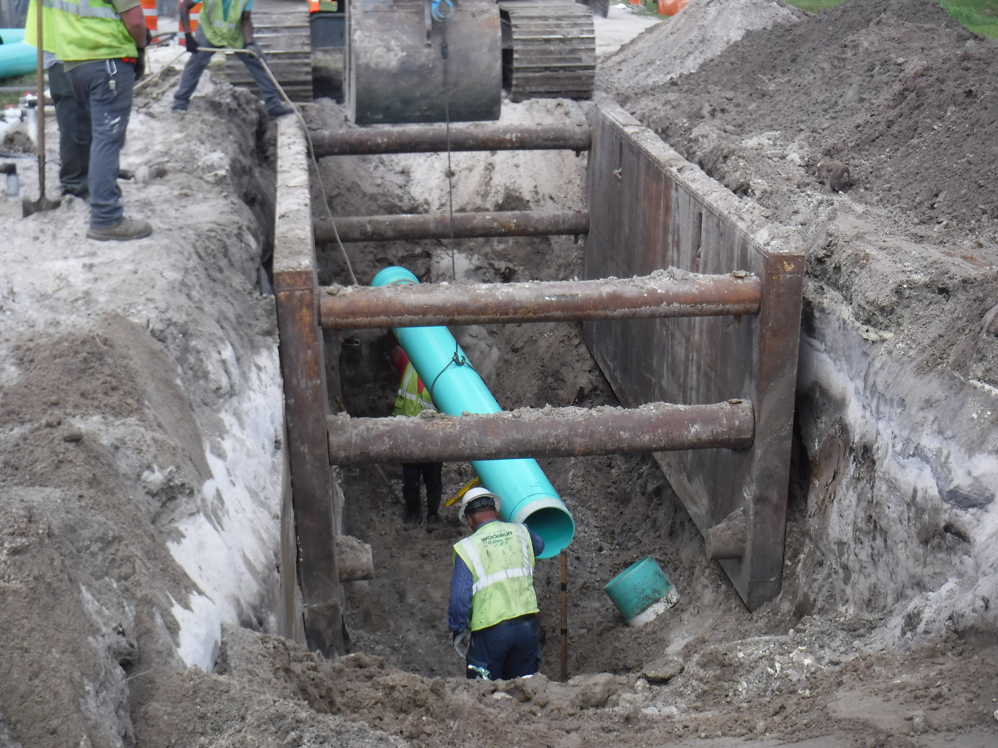
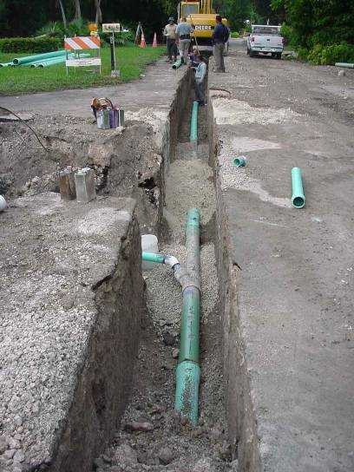
Possible solutions include alternative sewer collection and transmission systems
Conventional gravity sewers
Larger diameter
Deeper installation
Low pressure, vacuum sewers
Smaller diameter
Shallower installation

Slide 17
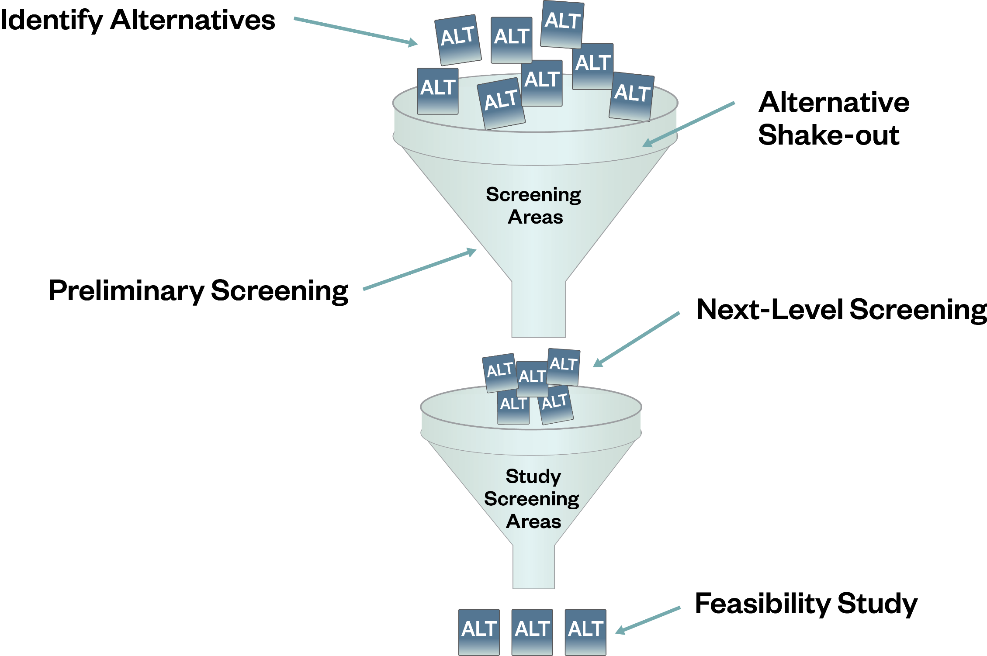
Possible solutions are being screened using decision making criteria
Project Area Characterization

Slide 18
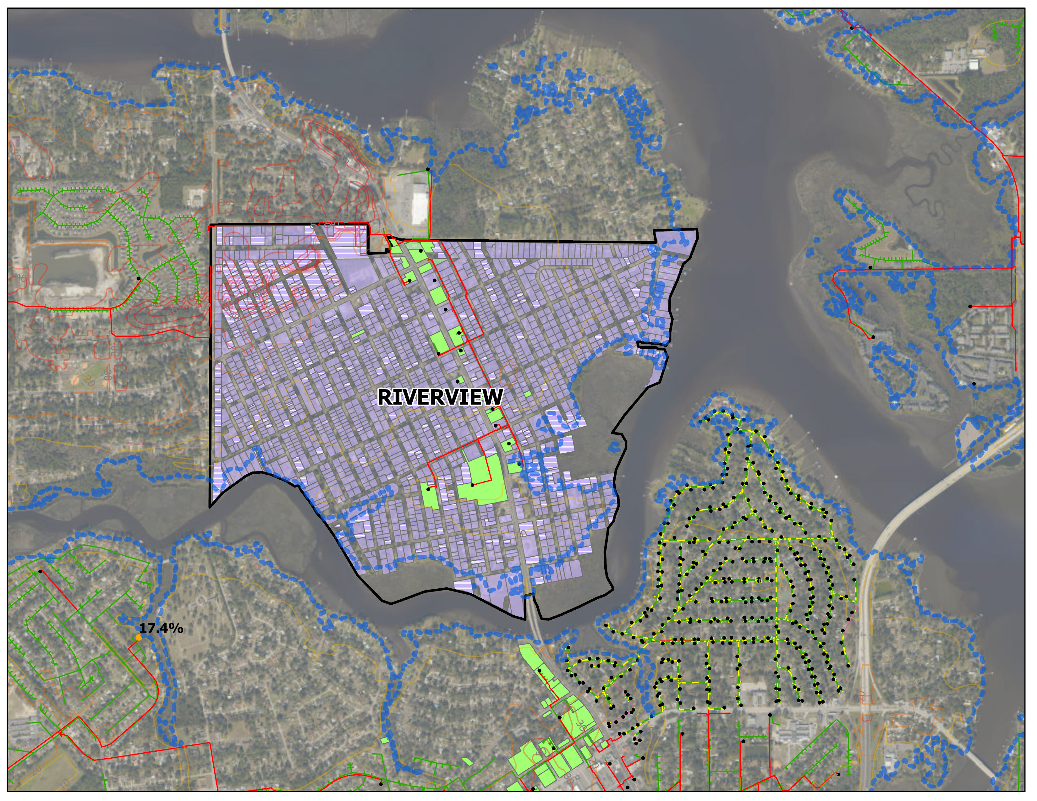
Characterization of the STPO project areas will be used in screening possible solutions
Rise in Sea Level YR2060
Ex. WW Network
Characterization:
Existing customers
Land Use
Existing Utilities
Topography
Environmental factors (including sea level rise)
Septic System
Ex. Customer

Slide 19
Criteria will be used to screen potential technical solution(s) within already prioritized STPO areas
Maximize Benefits of WW Management Alternatives
Implement
Environmental Impacts
Nitrogen Reduction
Ability to Phase
Ease of Siting
Cost
General impact to rate payers
Ease of Management
Construction Impacts (Env.)
Secondary Impacts
Odor/
Aesthetic
Short Term Construction Impacts
Reliability
Climate Resiliency
Regulatory Acceptance
Potential for Reuse
Potential for Disruption from Construction Breakage
Public Perception

Slide 20
Phase 1 and Phase 2 are 40% complete and projected to be finished by May 2021
 | Completion Date
Phase 1 Reporting | 12/2020
Phase 2 Master Plan Report | 05/2021

Slide 21
Project Timeline – major deliverables to completion
 | 2019 |  |  | 2020 |  |  |  |  |  |  |  |  |  |  |  | 2021
 | 10 | 11 | 12 | 01 | 02 | 03 | 04 | 05 | 06 | 07 | 08 | 09 | 10 | 11 | 12 | 01 | 02 | 03 | 04 | 05
Lit. Review
Technology Screening
Strategies Screening
Phase 1 Reporting
Project Area Characteriz.
Project Area Screening
Phase 2 Master Plan

Slide 22
Discussion
The most significant question: Capital
Current wastewater rates charge or recover operating, repair and replacement, contribution, etc. costs
Current wastewater rates do not charge or recover the cost or capital for septic tank phase-out
Will expand study work to include natural resource economic modeling

